Slide 1
Campaign 2022
What’s at stake in the governor’s race

Slide 2
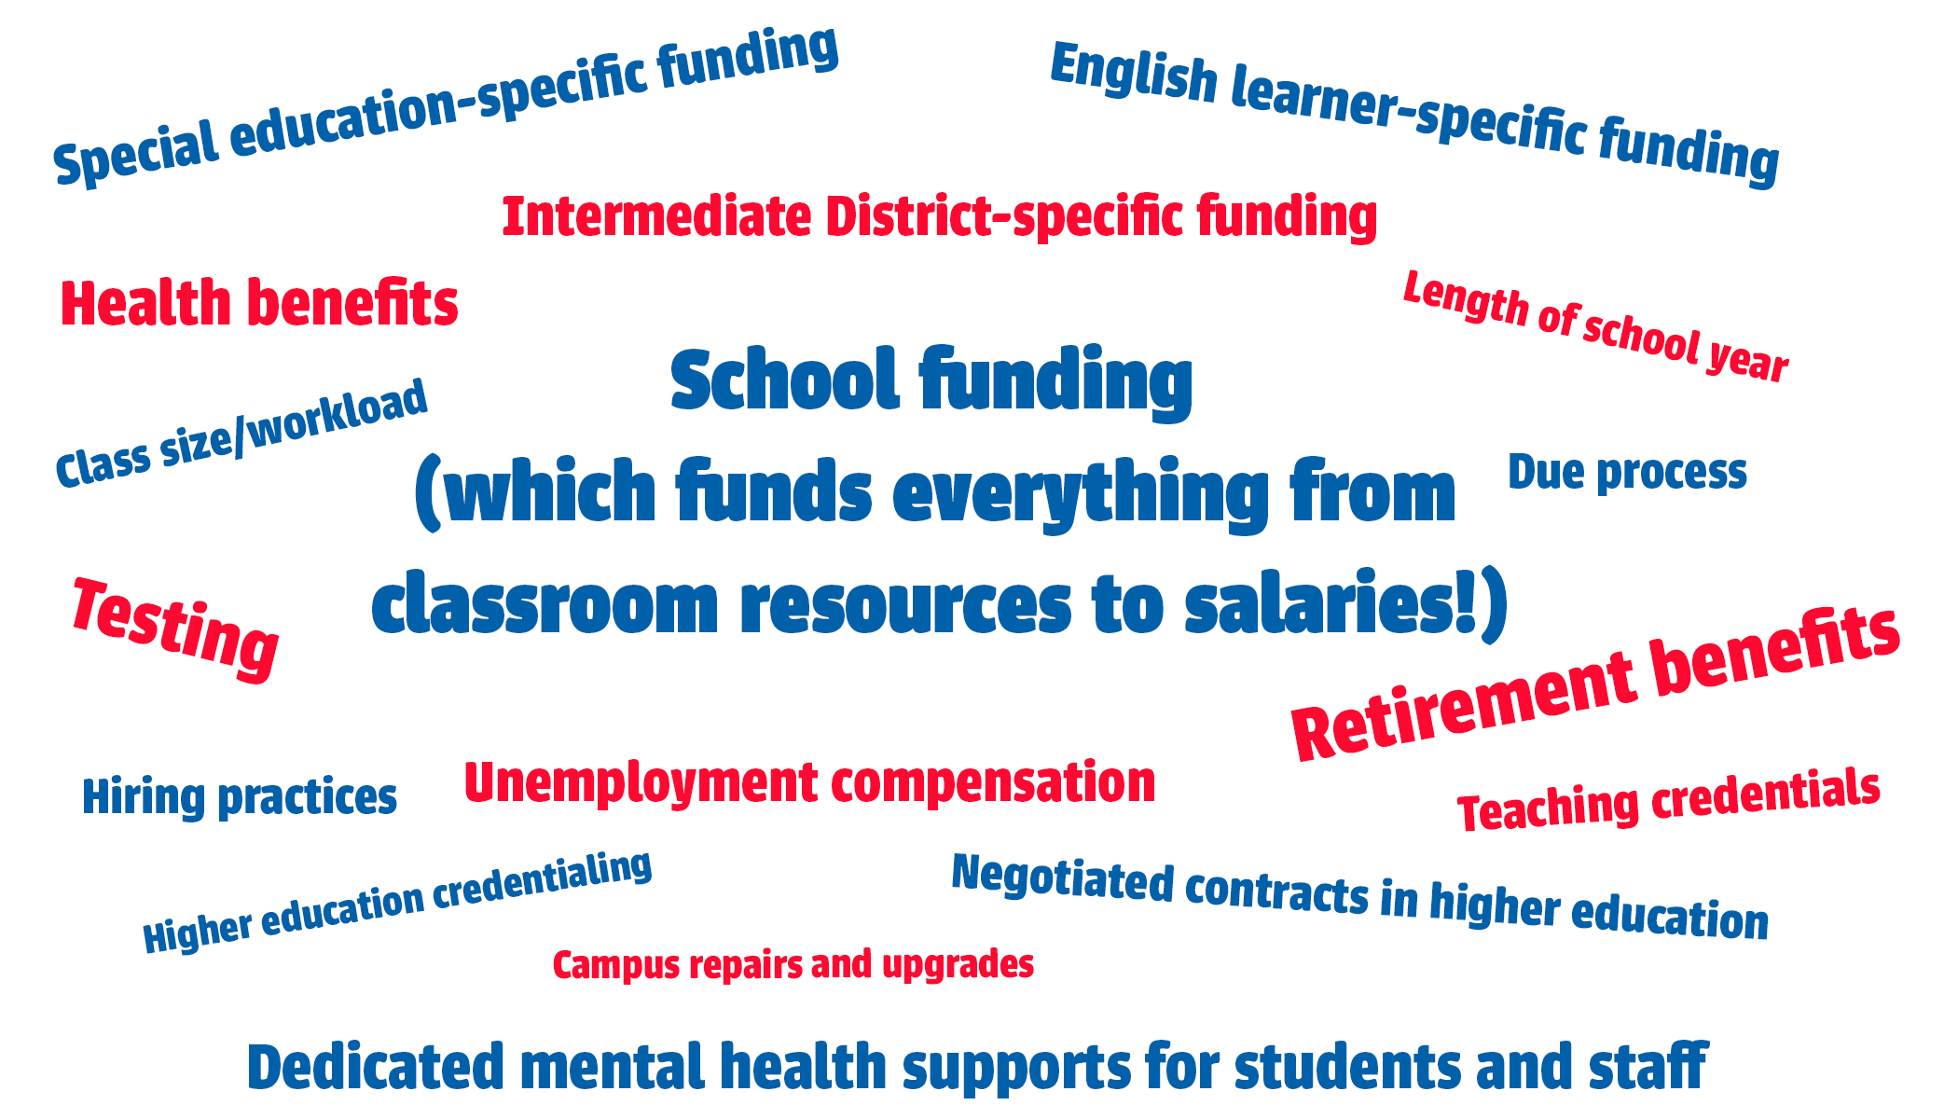
You may not be into politics, but politics is into you.
How does the governor influence our work in education?
Notes:
In 2018, then candidate Tim Walz told educators, “You may not be into politics, but politics is into you.”
Ask members to think about all of the ways the governor has influence the work in schools. Don’t read off the list of words but say, this is just a handful of the ways that the governor can change, take away or make better our work in education and schools.

Slide 3
The future of our union
The governor also can decide whether or not our state continues to have the right to collectively negotiate for better pay and benefits and learning and working conditions.
Notes:
In Minnesota, union membership is at a 14-year high. But the ability for public sector workers to organize and negotiate is something the governor most certainly can control. We saw the impact of elections in Wisconsin and Iowa as it relates to educators’ ability to have a robust union that bargains for better pay, benefits and working conditions.

Slide 4
The future of our union
In Iowa, anti-union lawmakers took control of the Senate, House and governor’s office and decimated collective bargaining laws in 10 days after the legislative session began in January 2017.
The new law limits most public-sector union contract negotiations to only base wages. Unions are now banned from negotiating with their employers over issues such as health insurance, evaluation procedures, staff reduction and leaves of absence for political purposes.
The law also says that unions cannot have union dues deducted from public employees’ paychecks.
Notes:
In Iowa, anti-union lawmakers took control of the Senate, House and governor’s office and decimated collective bargaining laws in 10 days after the legislative session began in January 2017.
The new law limits most public-sector union contract negotiations to only base wages. Unions are now banned from negotiating with their employers over issues such as health insurance, evaluation procedures, staff reduction and leaves of absence for political purposes. The law also says that unions cannot have union dues deducted from public employees’ paychecks.

Slide 5
The future of our union
In Wisconsin, Act 10 passed in 2011, which eliminated collective bargaining rights for most public-sector workers.
Teacher compensation plummeted $10,483 within four years of Act 10 passing.
Notes:
In Wisconsin, Act 10 passed in 2011, which eliminated collective bargaining rights for most public-sector workers.
Teacher compensation plummeted $10,483 within four years of Act 10 passing.

Slide 6
Why do we need educators to vote?
In 2022, we must choose leaders who will govern for all of us. By voting for a pro-public education House and Senate in 2018, we have seen increases in funding and dedicated mental health supports.
When educators stand together and make our voices heard in our hometowns and at the Capitol, we can create the learning conditions our students deserve.
Notes:
Why do we all need to vote? In 2022, we must choose leaders who will govern for all of us. By voting for a pro-public education House and Senate in 2018, we have seen increases in funding and dedicated mental health supports. Educators made the difference in the 2018 election!
When educators stand together and make our voices heard in our hometowns and at the Capitol, we can create the learning conditions our students deserve.

Slide 7
Why do we need educators to vote?
Certain corporate politicians plan to take away our freedom to negotiate for a fair return for our work and to advocate together for the services our students need. They’re covering for the richest corporations and CEOs because they fear our power to make them finally pay what they truly owe to our communities and schools.
This year, by joining together as voters, we can elect leaders who will respect us, not just the wealthy and powerful.
Notes:
Certain corporate politicians plan to take away our freedom to negotiate for a fair return for our work and to advocate together for the services our students need. They’re covering for the richest corporations and CEOs because they fear our power to make them finally pay what they truly owe to our communities and schools.
This year, by joining together as voters, we can elect leaders who will respect us, not just the wealthy and powerful.

Slide 8
Governor candidate comparison
What issues in education are you most concerned about?
Let’s see where the candidates stand on issues related to education.
Notes:
Ask members to share what issues in education they are most concerned about.
Find one or two issues your colleagues shared that are reflected on the governor candidate comparison handout.
Read the differences between what Gov. Walz has said about his support on that topic and what Scott Jensen has said.
Ask member to report our anything that surprised them about their answers or anything on the handout.
Ask members to take the document home and read through the whole document and ask them to share this information with their family, friends and colleagues.

Slide 9
Let’s go vote!
Educators take pride in voting! However, 33,000 of us missed the 2014 election for governor, and about 15,000 of us missed the 2018 election.
Minnesota elections, including when Mark Dayton was elected governor in 2010, have been decided by 8,000 votes or fewer – so educator votes can make a difference!
Educators teach their students every year that, in America, voting is a fundamental freedom that every citizen should exercise. It’s time to model that behavior in 2022!
Notes:
Share out any planned voting activities at your worksite.
Voting is easy in Minnesota! You can cast your ballots early starting Sept. 23 and Election Day is Tuesday, Nov. 8.
Pass out the half-sheet flyers with voting information and have people go to www.mnvotes.org to find their polling place and fill it in on the sheet!
Remind members they can visit www.edmnvotes.org to learn more about voting and what your union is doing to support pro-public education candidates in 2022.

